Slide 1
Defining Classes and Methods
Chapter 5

Slide 2
Objectives
Describe concepts of class, class object
Create class objects
Define a Java class, its methods
Describe use of parameters in a method
Use modifiers public, private
Define accessor, mutator class methods
Describe information hiding, encapsulation
Write method pre- and postconditions

Slide 3
Objectives
Describe purpose of javadoc
Draw simple UML diagrams
Describe references, variables, parameters of a class type
Define boolean-valued methods such as equals
Use image effects, labels and a simple layout in JavaFX Applications

Slide 4
Class and Method Definitions: Outline
Class Files and Separate Compilation
Instance Variables
Methods
The Keyword this
Local Variables
Blocks
Parameters of a Primitive Type

Slide 5
Class and Method Definitions
Java program consists of objects
Objects of class types
Objects that interact with one another
Program objects can represent
Objects in real world
Abstractions

Slide 6
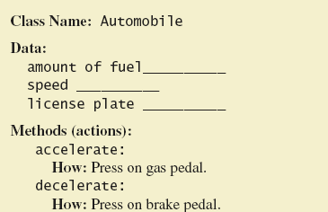
Class and Method Definitions
Figure 5.1 A class as a blueprint

Slide 7
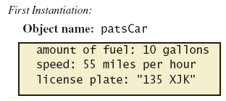
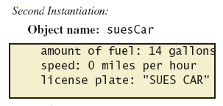
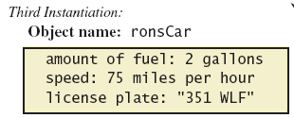
Class and Method Definitions
Figure 5.1 ctd.
Objects that are instantiations of the class Automobile

Slide 8
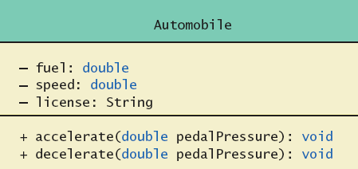
Class and Method Definitions
Figure 5.2 A class outline as a UML class diagram

Slide 9
Class Files and Separate Compilation
Each Java class definition usually in a file by itself
File begins with name of the class
Ends with .java
Class can be compiled separately
Helpful to keep all class files used by a program in the same directory

Slide 10
Dog class and Instance Variables
View sample program, listing 5.1 class Dog
Note class has
Three pieces of data (instance variables)
Two behaviors
Each instance of this type has its own copies of the data items
Use of public
No restrictions on how variables used
Later will replace with private

Slide 11
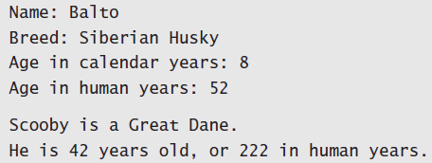
Using a Class and Its Methods
View sample program, listing 5.2 class DogDemo
Sample screen output

Slide 12
Methods
When you use a method you "invoke" or "call" it
Two kinds of Java methods
Return a single item
Perform some other action – a void method
The method main is a void method
Invoked by the system
Not by the application program

Slide 13
Methods
Calling a method that returns a quantity
Use anywhere a value can be used
Calling a void method
Write the invocation followed by a semicolon
Resulting statement performs the action defined by the method

Slide 14
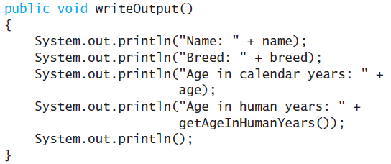
Defining void Methods
Consider method writeOutput from Listing 5.1
Method definitions appear inside class definition
Can be used only with objects of that class

Slide 15
Defining void Methods
Most method definitions we will see as public
Method does not return a value
Specified as a void method
Heading includes parameters
Body enclosed in braces { }
Think of method as defining an action to be taken

Slide 16
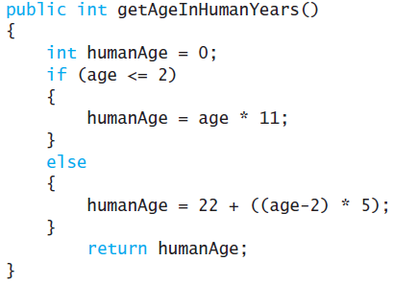
Methods That Return a Value
Consider method getAgeInHumanYears( )
Heading declares type of value to be returned
Last statement executed is return

Slide 17
Second Example – Species Class
Class designed to hold records of endangered species
View the class listing 5.3 class SpeciesFirstTry
Three instance variables, three methods
Will expand this class in the rest of the chapter
View demo class listing 5.4 class SpeciesFirstTryDemo

Slide 18
The Keyword this
Referring to instance variables outside the class – must use
Name of an object of the class
Followed by a dot
Name of instance variable
Inside the class,
Use name of variable alone
The object (unnamed) is understood to be there

Slide 19
The Keyword this
Inside the class the unnamed object can be referred to with the name this
Example this.name = keyboard.nextLine();
The keyword this stands for the receiving object
We will seem some situations later that require the this

Slide 20
Local Variables
Variables declared inside a method are called local variables
May be used only inside the method
All variables declared in method main are local to main
Local variables having the same name and declared in different methods are different variables

Slide 21
Local Variables
View sample file, listing 5.5A class BankAccount
View sample file, listing 5.5B class LocalVariablesDemoProgram
Note two different variables newAmount
Note different values output
Sample screen output

Slide 22
Blocks
Recall compound statements
Enclosed in braces { }
When you declare a variable within a compound statement
The compound statement is called a block
The scope of the variable is from its declaration to the end of the block
Variable declared outside the block usable both outside and inside the block

Slide 23
Parameters of Primitive Type
Recall method declaration in listing 5.3
Note it only works for 10 years
We can make it more versatile by giving the method a parameter to specify how many years
Note sample program, listing 5.6 class SpeciesSecondTry

Slide 24
Parameters of Primitive Type
Note the declaration public int predictPopulation(int years)
The formal parameter is years
Calling the method int futurePopulation = speciesOfTheMonth.predictPopulation(10);
The actual parameter is the integer 10
View sample program, listing 5.7 class SpeciesSecondClassDemo

Slide 25
Parameters of Primitive Type
Parameter names are local to the method
When method invoked
Each parameter initialized to value in corresponding actual parameter
Primitive actual parameter cannot be altered by invocation of the method
Automatic type conversion performed byte -> short -> int -> long -> float -> double

Slide 26
Information Hiding, Encapsulation: Outline
Information Hiding
Pre- and Postcondition Comments
The public and private Modifiers
Methods Calling Methods
Encapsulation
Automatic Documentation with javadoc
UML Class Diagrams

Slide 27
Information Hiding
Programmer using a class method need not know details of implementation
Only needs to know what the method does
Information hiding:
Designing a method so it can be used without knowing details
Also referred to as abstraction
Method design should separate what from how

Slide 28
Pre- and Postcondition Comments
Precondition comment
States conditions that must be true before method is invoked
Example

Slide 29
Pre- and Postcondition Comments
Postcondition comment
Tells what will be true after method executed
Example

Slide 30
The public and private Modifiers
Type specified as public
Any other class can directly access that object by name
Classes generally specified as public
Instance variables usually not public
Instead specify as private
View sample code, listing 5.8 class SpeciesThirdTry

Slide 31
Programming Example
Demonstration of need for private variables
View sample code, listing 5.9
Statement such as box.width = 6; is illegal since width is private
Keeps remaining elements of the class consistent in this example

Slide 32
Programming Example
Another implementation of a Rectangle class
View sample code, listing 5.10 class Rectangle2
Note setDimensions method
This is the only way the width and height may be altered outside the class

Slide 33
Accessor and Mutator Methods
When instance variables are private must provide methods to access values stored there
Typically named getSomeValue
Referred to as an accessor method
Must also provide methods to change the values of the private instance variable
Typically named setSomeValue
Referred to as a mutator method

Slide 34
Accessor and Mutator Methods
Consider an example class with accessor and mutator methods
View sample code, listing 5.11 class SpeciesFourthTry
Note the mutator method
setSpecies
Note accessor methods
getName, getPopulation, getGrowthRate

Slide 35
Accessor and Mutator Methods
Using a mutator method
View sample program, listing 5.12 classSpeciesFourthTryDemo
Sample screen output

Slide 36
Programming Example
A Purchase class
View sample code, listing 5.13 class Purchase
Note use of private instance variables
Note also how mutator methods check for invalid values
View demo program, listing 5.14 class purchaseDemo

Slide 37
Programming Example
Sample screen output

Slide 38
Methods Calling Methods
A method body may call any other method
If the invoked method is within the same class
Need not use prefix of receiving object
View sample code, listing 5.15 class Oracle
View demo program, listing 5.16 class OracleDemo

Slide 39
Methods Calling Methods
Sample screen output

Slide 40
Encapsulation
Consider example of driving a car
We see and use break pedal, accelerator pedal, steering wheel – know what they do
We do not see mechanical details of how they do their jobs
Encapsulation divides class definition into
Class interface
Class implementation

Slide 41
Encapsulation
A class interface
Tells what the class does
Gives headings for public methods and comments about them
A class implementation
Contains private variables
Includes definitions of public and private methods

Slide 42
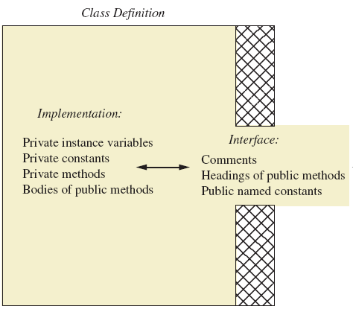
Encapsulation
Figure 5.3 A well encapsulated class definition
Programmer who uses the class

Slide 43
Encapsulation
Preface class definition with comment on how to use class
Declare all instance variables in the class as private.
Provide public accessor methods to retrieve data Provide public methods manipulating data
Such methods could include public mutator methods.
Place a comment before each public method heading that fully specifies how to use method.
Make any helping methods private.
Write comments within class definition to describe implementation details.

Slide 44
Automatic Documentation javadoc
Generates documentation for class interface
Comments in source code must be enclosed in /** */
Utility javadoc will include
These comments
Headings of public methods
Output of javadoc is HTML format

Slide 45
UML Class Diagrams
Recall Figure 5.2 A class outline as a UML class diagram

Slide 46
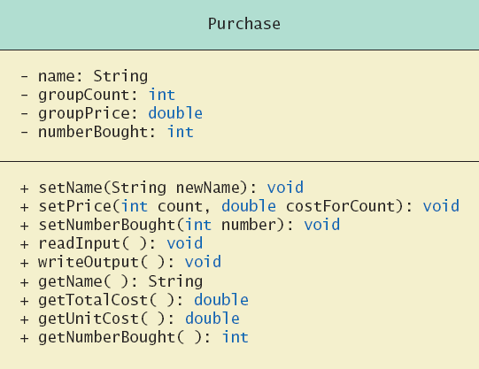
UML Class Diagrams
Note Figure 5.4 for the Purchase class
Minus signs imply private access
Plus signs imply public access

Slide 47
UML Class Diagrams
Contains more than interface, less than full implementation
Usually written before class is defined
Used by the programmer defining the class
Contrast with the interface used by programmer who uses the class

Slide 48
Objects and References: Outline
Variables of a Class Type
Defining an equals Method for a Class
Boolean-Valued Methods
Parameters of a Class Type

Slide 49
Variables of a Class Type
All variables are implemented as a memory location
Data of primitive type stored in the memory location assigned to the variable
Variable of class type contains memory address of object named by the variable

Slide 50
Variables of a Class Type
Object itself not stored in the variable
Stored elsewhere in memory
Variable contains address of where it is stored
Address called the reference to the variable
A reference type variable holds references (memory addresses)
This makes memory management of class types more efficient

Slide 51
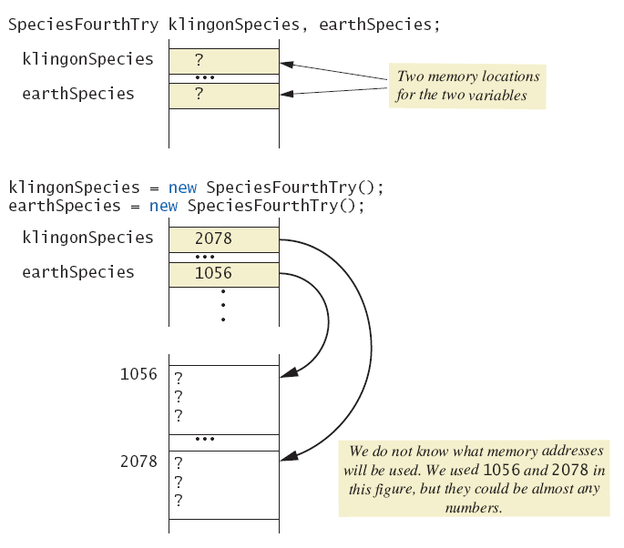
Variables of a Class Type
Figure 5.5a Behavior of class variables

Slide 52
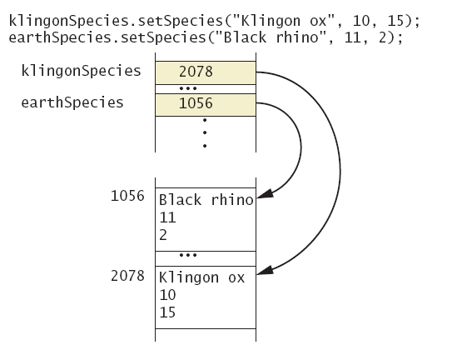
Variables of a Class Type
Figure 5.5b Behavior of class variables

Slide 53
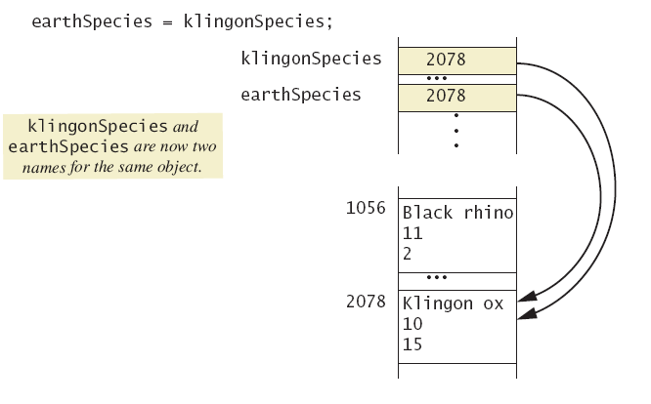
Variables of a Class Type
Figure 5.5c Behavior of class variables

Slide 54
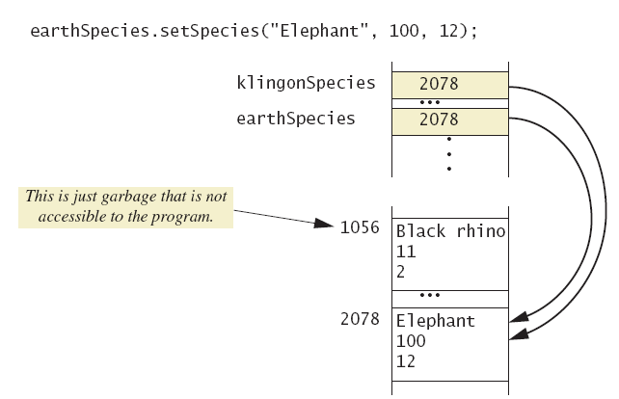
Variables of a Class Type
Figure 5.5d Behavior of class variables

Slide 55
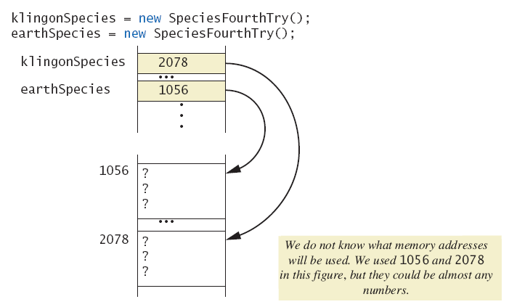
Variables of a Class Type
Figure 5.6a Dangers of using == with objects

Slide 56
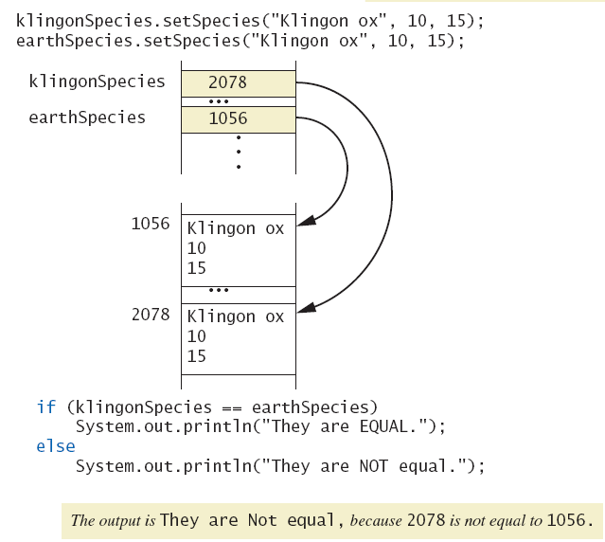
Variables of a Class Type
Figure 5.6b Dangers of using == with objects

Slide 57
Variables of a Class Type
Figure 5.6b Dangers of using == with objects

Slide 58
Defining an equals Method
As demonstrated by previous figures
We cannot use == to compare two objects
We must write a method for a given class which will make the comparison as needed
View sample code, listing 5.17 class Species
The equals for this class method used same way as equals method for String

Slide 59
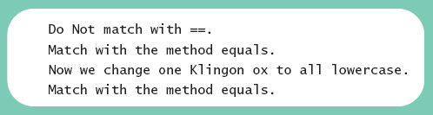
Demonstrating an equals Method
View sample program, listing 5.18 class SpeciesEqualsDemo
Note difference in the two comparison methods == versus .equals( )
Sample screen output

Slide 60
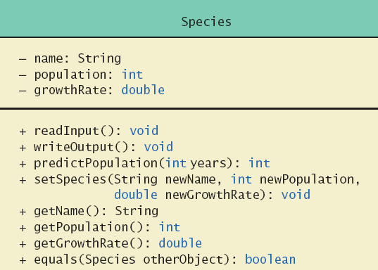
Complete Programming Example
View sample code, listing 5.19 class Species
Figure 5.7 Class Diagram for the class Species in listing 5.19

Slide 61
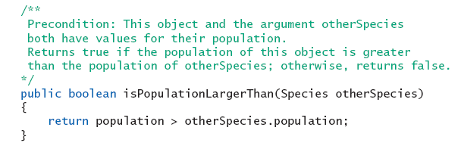
Boolean-Valued Methods
Methods can return a value of type boolean
Use a boolean value in the return statement
Note method from listing 5.19

Slide 62
Unit Testing
A methodology to test correctness of individual units of code
Typically methods, classes
Collection of unit tests is the test suite
The process of running tests repeatedly after changes are make sure everything still works is regression testing
View sample code, listing 5.20 class SpeciesTest

Slide 63
Parameters of a Class Type
When assignment operator used with objects of class type
Only memory address is copied
Similar to use of parameter of class type
Memory address of actual parameter passed to formal parameter
Formal parameter may access public elements of the class
Actual parameter thus can be changed by class methods

Slide 64
Programming Example
View sample code, listing 5.21 class DemoSpecies
Note different parameter types and results
View sample program, listing 5.22
Parameters of a class type versus parameters of a primitive type class ParametersDemo

Slide 65
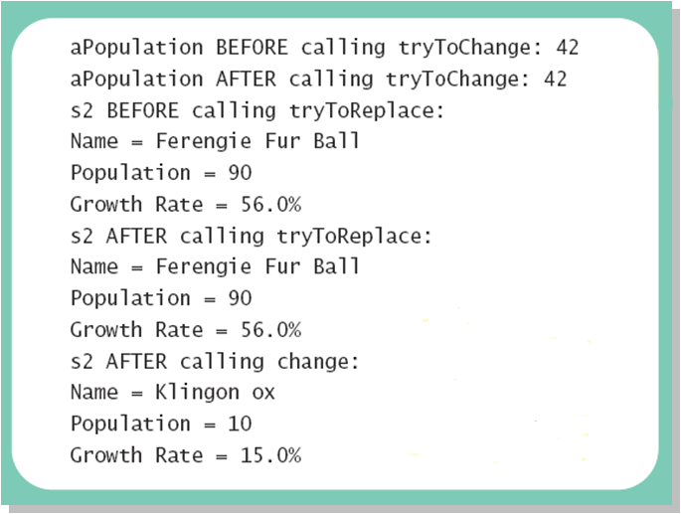
Programming Example
Sample screen output

Slide 66
Graphics Supplement: Outline
The GraphicsContext Class
Adding Labels to a JavaFX Application

Slide 67
The GraphicsContext Class
An object of the GraphicsContext class represents an area of the screen
JavaFX applications use the metaphor of a Stage and Scene
The Scene object contains a set of Nodes called a scene graph that describes a scene of the applications, just like the script, actors, and props describe a scene in a play or movie
In our simple JavaFX application we create a special type of Node called a Group that contains other Nodes and can auto-size based on the nodes within the group
At this point, sufficient to know that GraphicsContext is a class that allows us to draw figures and write text in an area of the application

Slide 68
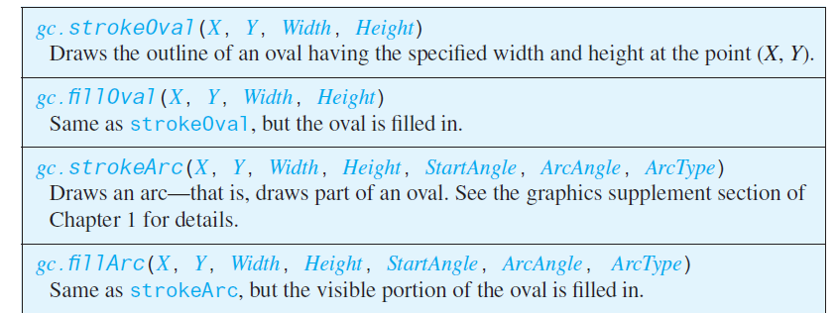
The GraphicsContext Class
Figure 5.8a Some methods in class GraphicsContext

Slide 69
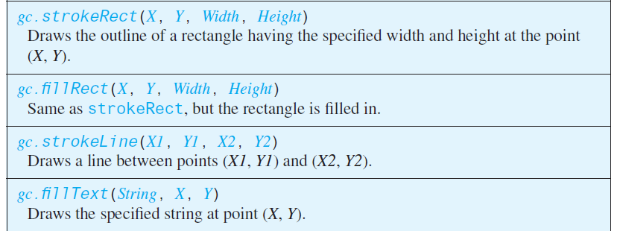
The GraphicsContext Class
Figure 5.8b Some methods in class GraphicsContext

Slide 70
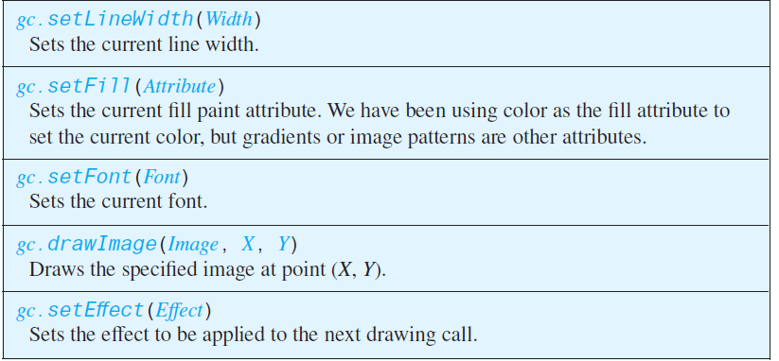
The GraphicsContext Class
Figure 5.8c Some methods in class GraphicsContext

Slide 71
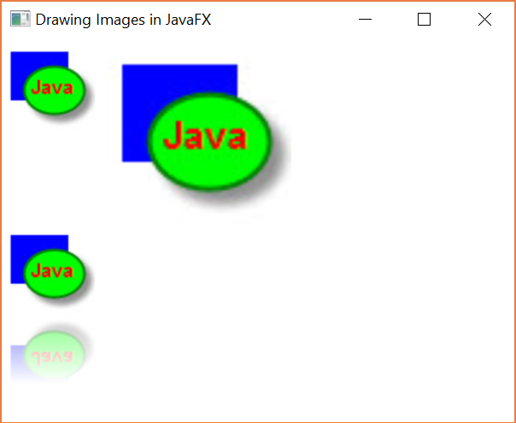
Drawing Images and Applying Effects
We can use the drawImage method to draw an image on the screen and apply a variety of image effects
View sample program, listing 5.23, for reading an image file and drawing it with scale and reflection

Slide 72
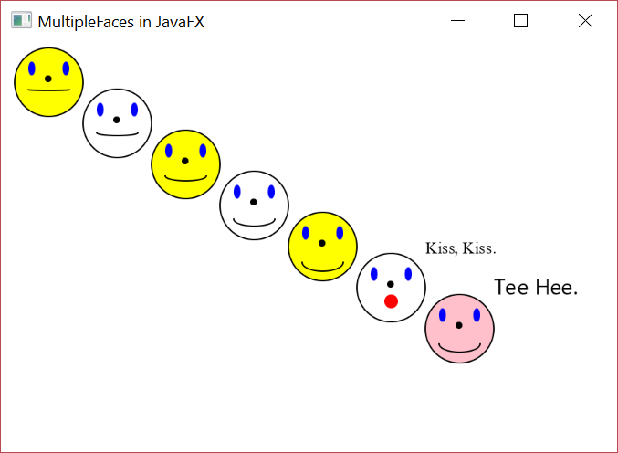
Programming Example
Multiple faces – using a Helping method
View sample code, listing 5.24 class MultipleFaces
Sample screen output

Slide 73
Adding Labels to a JavaFX Application
Provides a way to add text to an application
More flexible than using fillText
Add a Label in conjunction with a Layout which specifies how components will be arranged visually in the window
Here we use a simple vertical box layout, VBox

Slide 74
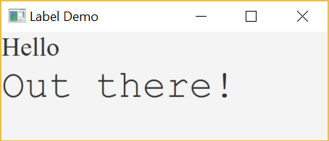
Adding Labels to a JavaFX Application
View sample application, listing 5.25 class LabelDemo
Sample screen output

Slide 75
Summary
Classes have
Instance variables to store data
Method definitions to perform actions
Instance variables should be private
Class needs accessor, mutator methods
Methods may be
Value returning methods
Void methods that do not return a value

Slide 76
Summary
Keyword this used within method definition represents invoking object
Local variables defined within method definition
Formal arguments must match actual parameters with respect to number, order, and data type
Formal parameters act like local variables

Slide 77
Summary
Parameter of primitive type initialized with value of actual parameter
Value of actual parameter not altered by method
Parameter of class type initialized with address of actual parameter object
Value of actual parameter may be altered by method calls
A method definition can include call to another method in same or different class

Slide 78
Summary
Precondition comment states conditions that must be true before method invoked
Postcondition comment describes resulting effects of method execution
Utility program javadoc creates documentation
Class designers use UML notation to describe classes
Operators = and == behave differently with objects of class types (vs. primitive types)

Slide 79
Summary
Designer of class should include an equals method
Graphics drawn by a JavaFX application normally done within GraphicsContext
Labels added to a JavaFX Layout

